Slide 1
Nonlinear simulation of structures using OpenSees
Compare the most common models for nonlinear simulation of structural members
Present the Open System for Earthquake Engineering Simulation (OpenSees)
Develop an OpenSees model using notebook scripting
Corotational

Slide 2
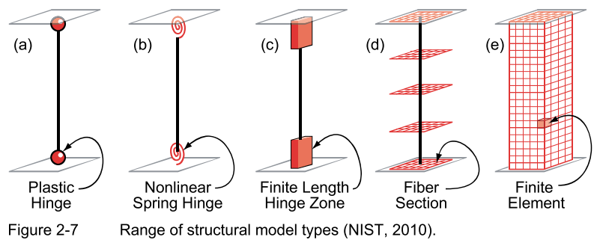
Element models

Slide 3
Concentrated vs. distributed plasticity models
Notes:
P-M interaction can be approximately incorporated in a concentrated uniaxial model by modifying the model parameters based on the average axial force expected in the member.

Slide 4
Overall Analysis Framework
structure
member
section
material
structure
member
section
material

Slide 5
Fiber beam-column elements
Fiber elements are discretized along their length (integration points) and across their cross-sections (fibers) to explicitly model the spread of plasticity
Two types of fiber beam-column elements
Displacement (stiffness) based fiber element | Force (flexibility) based fiber element
Formulated using PVD | Formulated using PVF
Follows standard FEA procedure of assuming a displacement interpolation function | Does not assume a displacement interpolation function, but instead, interpolates forces along length of member
Does not strictly enforce equilibrium along length of member | Strictly enforces equilibrium along length of member
Direct state determination (P,M given Δ) | Requires iterations within element formulation for state determination
Notes:
Mark the integration points and fibers on the diagram.

Slide 6
Member Integration – Kt
Notes:
Note that a specific scheme with a specific number of integration points provides an exact integration only up to a polynomial of certain order.

Slide 7
Member Integration – Kt

Slide 8
OpenSees
“OpenSees, the Open System for Earthquake Engineering Simulation, is an object-oriented, open-source software framework. It allows users to create both serial and parallel finite element computer applications for simulating the response of structural and geotechnical systems subjected to earthquakes and other hazards.”
https://opensees.berkeley.edu/wiki/index.php/Main_Page
OpenSees is a collection of objects for structural analysis. Similar to a Matlab toolbox, or a Python package.
Developed by PEER (Pacific Earthquake Engineering Research Center) following the Ph.D. thesis Object-Oriented Finite Element Programming: Frameworks for Analysis, Algorithm and Parallel Computing (1997), F. McKenna.

Slide 9
OpenSees
First structural analysis software that exploited the full potential of OOP, including analysis parallelization in multiple computer cores and nodes.
Open-source code that enables contributions from anyone worldwide. This expedites the dissemination and application of the latest research findings. Common contributions include:
New materials
New elements
New numerical solution methods
Full control of analysis methods to solve the system of equations of the structure

Slide 10
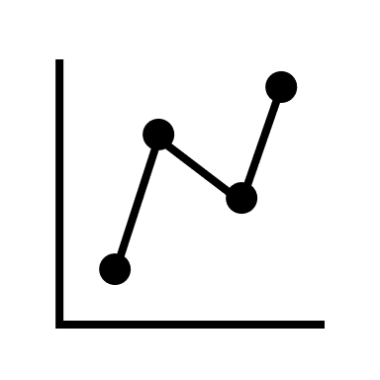
Structural analysis using OpenSees
Pre-processing
Prepare all the inputs for the analysis in a format that the solver understands
Processing
Assemble and solve the system of equations
Output desired results
Post-processing
Present the outputs of the processing (analysis) in a way that facilitates interpretation
Notes:
Draw analogy with MASTAN and their modeling code

Slide 11
General steps in pre-processing (in OpenSees)
Clear objects
Define dimensions and DOFs
Materials
Nodes
Boundary conditions
Nodal masses
Elements
Define special output
Apply gravity load
Apply other demands
Force controlled analysis
Displacement controlled analysis
Dynamic analysis
Define load
Define analysis methods
“Run” analysis
Hold gravity load
Reset time to zero
Define load
Define analysis methods
“Run” analysis

Slide 12
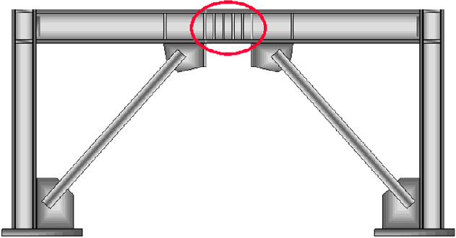
Module No. 1
L
L
Steel EBF
(b) RC coupled shear walls
Only degree of freedom
L
(c) Simplified model for EBF link or coupling beams

Slide 13
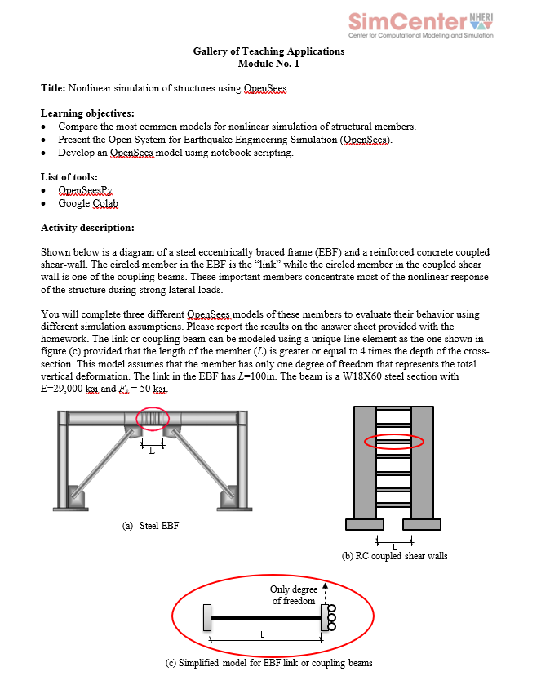
Module No. 1

Slide 14
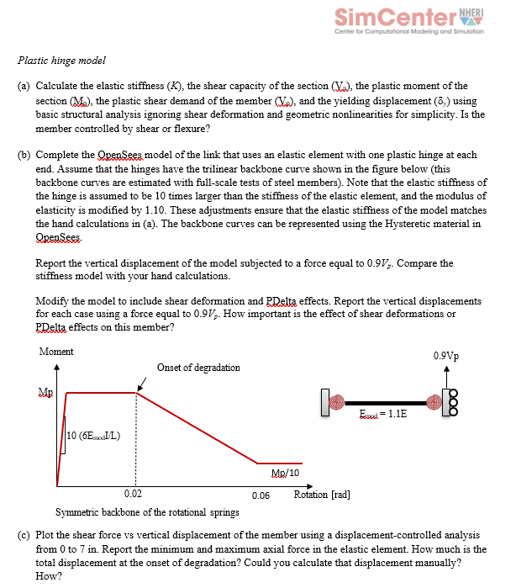
Module No. 1: Solving parts (a) to (c) in class

Slide 15
Module No. 1: steps in pre-processing
Clear objects
Define dimensions and DOFs
Materials
Nodes
Boundary conditions
Nodal masses
Elements
Define special output
Apply gravity load
Apply other demands
Force controlled analysis
Displacement controlled analysis
Acceleration time history analysis
Only degree of freedom
L
(c) Simplified model for EBF link or coupling beams

