Slide 1

Uncertainty Quantification of Pushover Curves
Introduce the concept of nonlinear static analysis (NSA).
Describe the general computational workflow for NSA.
Quantify uncertainty in the nonlinear response of structures.

Slide 2
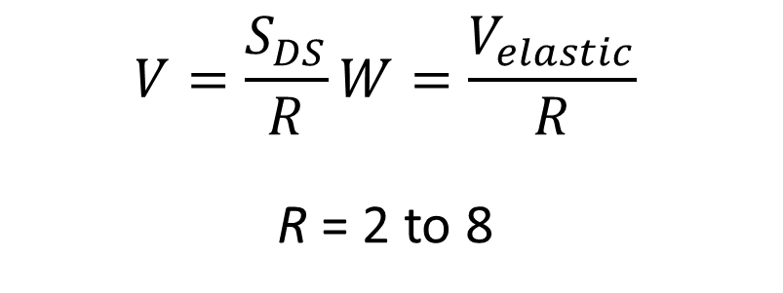
Conventional Seismic Design
Traditional (Building code) Approach for New Buildings
Linear analysis model
Simplified design base shear
Prescriptive details
Uncertain outcomes
Owners informed of code conformance, but not building performance.
O
P
E
N
$$V=\frac{S_{DS}}{R}W=\frac{V_{elastic}}{R}$$
R = 2 to 8

Slide 3
Conventional Seismic Design
In design by elastic analysis, nonlinear behavior is represented by an “R factor” that accounts for:
Ductility: ability of a member to deform beyond its elastic limit and maintain load carrying capability
Energy dissipation
Material overstrength
System overstrength, sequential distributed yielding
Damping from non-structural components
Nonlinear dynamics (stiffness reduction, incoherence in response, etc.)

Slide 4
Pushover concept
O
P
E
N
O
P
E
N
O
P
E
N
Base Shear
nonlinear static pushover analysis
Deformation
Notes:
A lot encapsulated in the R factor.
A pushover or NSA is the next level of analysis above linear elastic that enables a better understanding of structural behavior and avoiding the reliance on a one-fits-all R factor.
Concept: push the building with a constant and increasing load patter

Slide 5
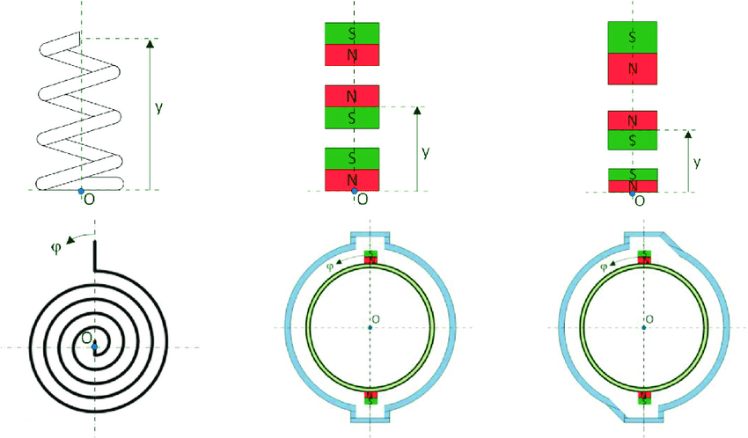
Setting up a non-linear model
One of the simplest building models possible already needs 18+ parameter values. How certain are you of those values?
Panel zone
Column
Beam
Notes:
Computing a pushover curve requires a nonlinear model that has many input parameters

Slide 6
Uncertainty in pushover curves
Base Shear
Deformation
Notes:
The uncertainty in the parameters means uncertainty in the performance

Slide 7
Uncertainty in pushover curves
O
P
E
N
Base Shear
O
P
E
N
Deformation
Notes:
That means that for the same displacement the building could be collapsed or even functional depending on the parameters
How large is the uncertainty in the performance?
How can engineer consider this in design?

Slide 8
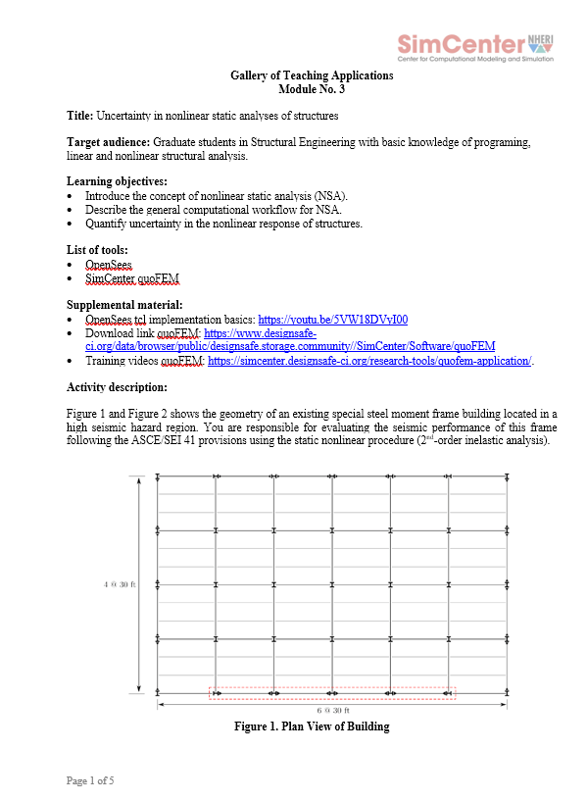
Module No. 3

Slide 9
Module No. 3: Solving parts 1 and 2 in class
Lecture workflow:
Review the problem statement together
Inspect all the Inputs and starter code
Solve part 1
Solve part 2

Slide 10
Module No. 3: Solving parts 1 and 2 in class
Note to instructor:
In this part of the lecture the idea is to open the problem statement and start solving it. Slowly walk through the solution with the students and all the inputs. This helps explain OpenSees tcl syntax and quoFEM

