Slide 1
Ground motion selection and scaling for NLRHA
Introduction to nonlinear response history analysis (NLRHA)
General workflow for NLRHA
Ground motion selection and scaling criteria
Example

Slide 2
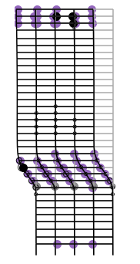





Motivation
Most extreme demands on structures vary with time!
Accurate simulation of the dynamic response of structures enables:
Safer designs
Cost-effective projects
Reliable performance
Functional/comfortable structures

Slide 3
Static vs Dynamic analysis
Goal: quantify the response of a structure subjected to an external demand that varies with time.
Static
Dynamic
u
u
P
F_{i}(t)
P(t)
0.5F_{s}
0.5F_{s}(t)
0.5F_{s}(t)
0.5F_{s}
F_{d}(t)
Equation of equilibrium:
Equation of equilibrium:
F_{s} = P
F_{i}(t) + F_{d}(t) + F_{s}(t) = P(t)

Slide 4
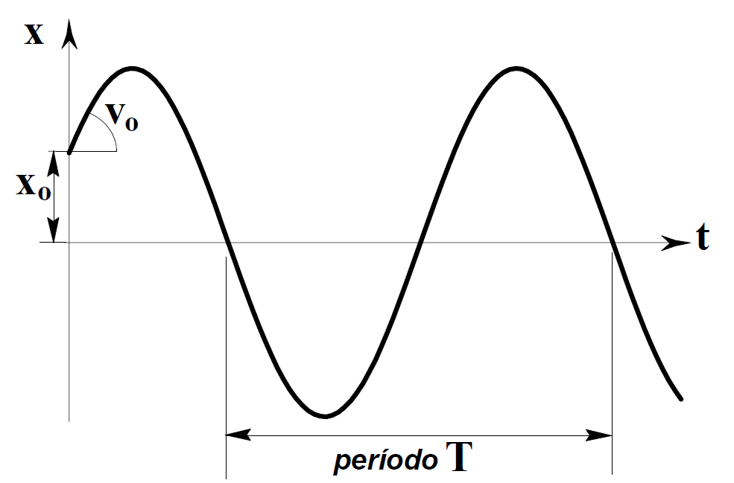

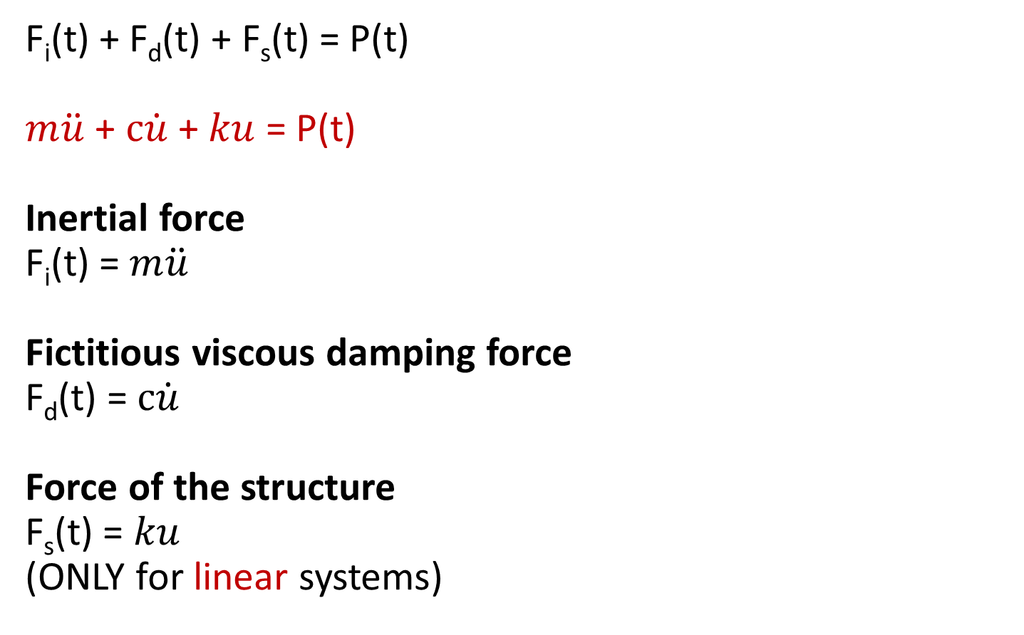
Terms of the dynamic equation of equilibrium
F_{i}(t) + F_{d}(t) + F_{s}(t) = P(t)
$m\ddot{u}$ + $c\dot{u}$ + $ku$ = P(t)
Inertial force
F_{i}(t) = $m\ddot{u}$
Fictitious viscous damping force
F_{d}(t) = $c\dot{u}$
Force of the structure
F_{s}(t) = $ku$
(ONLY for linear systems)
System properties:
m, ξ, k, …
$$T=2π\sqrt{\frac{m}{k}}$$
Period, T

Slide 5
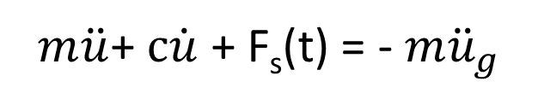
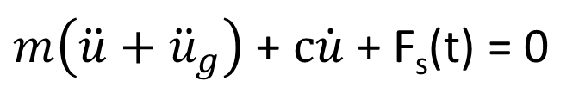


Ground motion time history analysis
u
F_{i}(t)
F_{i}(t) + F_{d}(t) + F_{s}(t) = 0
0.5F_{s}(t)
0.5F_{s}(t)
$m\left(\ddot{u}+{\ddot{u}}_{g}\right)$ + $c\dot{u}$ + F_{s}(t) = 0
F_{d}(t)
u_{g}
u_{g}
u
$$m\ddot{u}$$
Equivalent system:
$$m{\ddot{u}}_{g}$$
0.5F_{s}(t)
$m\ddot{u}$+ $c\dot{u}$ + F_{s}(t) = - $m{\ddot{u}}_{g}$
0.5F_{s}(t)
F_{d}(t)

Slide 6
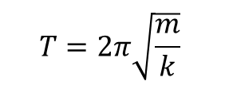
Effect of the vibration period
u
F_{i}(t)
0.5F_{s}(t)
ξ=0.05
0.5F_{s}(t)
F_{d}(t)
u_{g}
u_{g}
$$T=2π\sqrt{\frac{m}{k}}$$
T = 2.0 s
T = 0.5 s

Slide 7
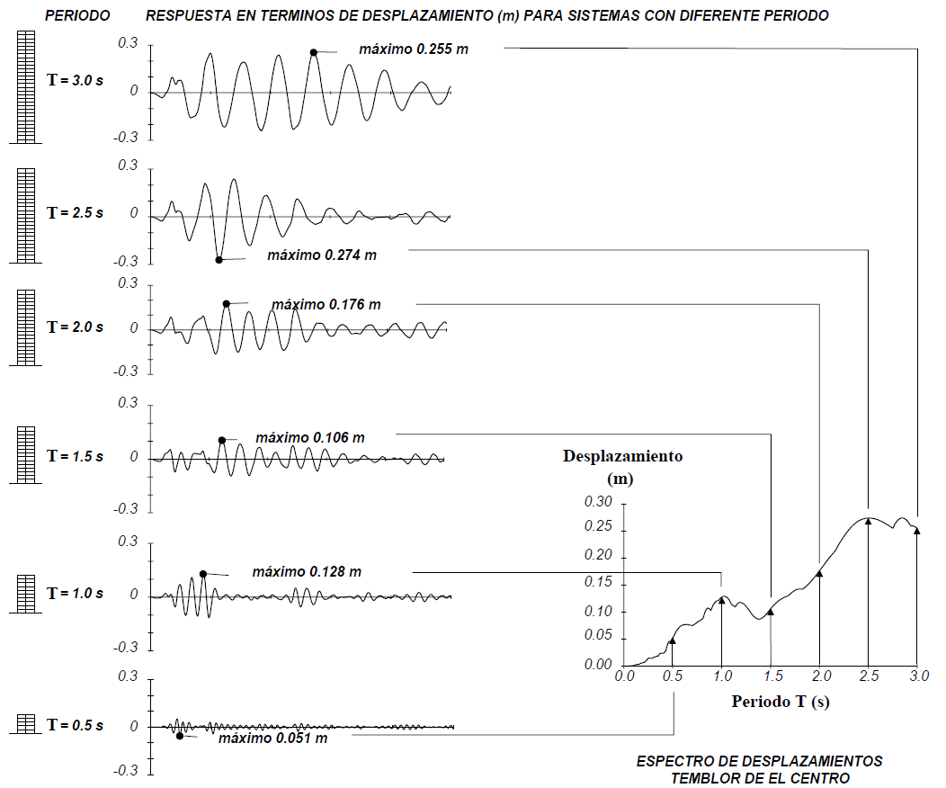
The concept of response spectrum
Period
Displacement response for systems with different period
Displacement
Period
Displacement response spectrum
for this ground motion
$$S_{d}(T)=\max\left(u\left(T\right)\right)$$
(Garcia, 1998)

Slide 8
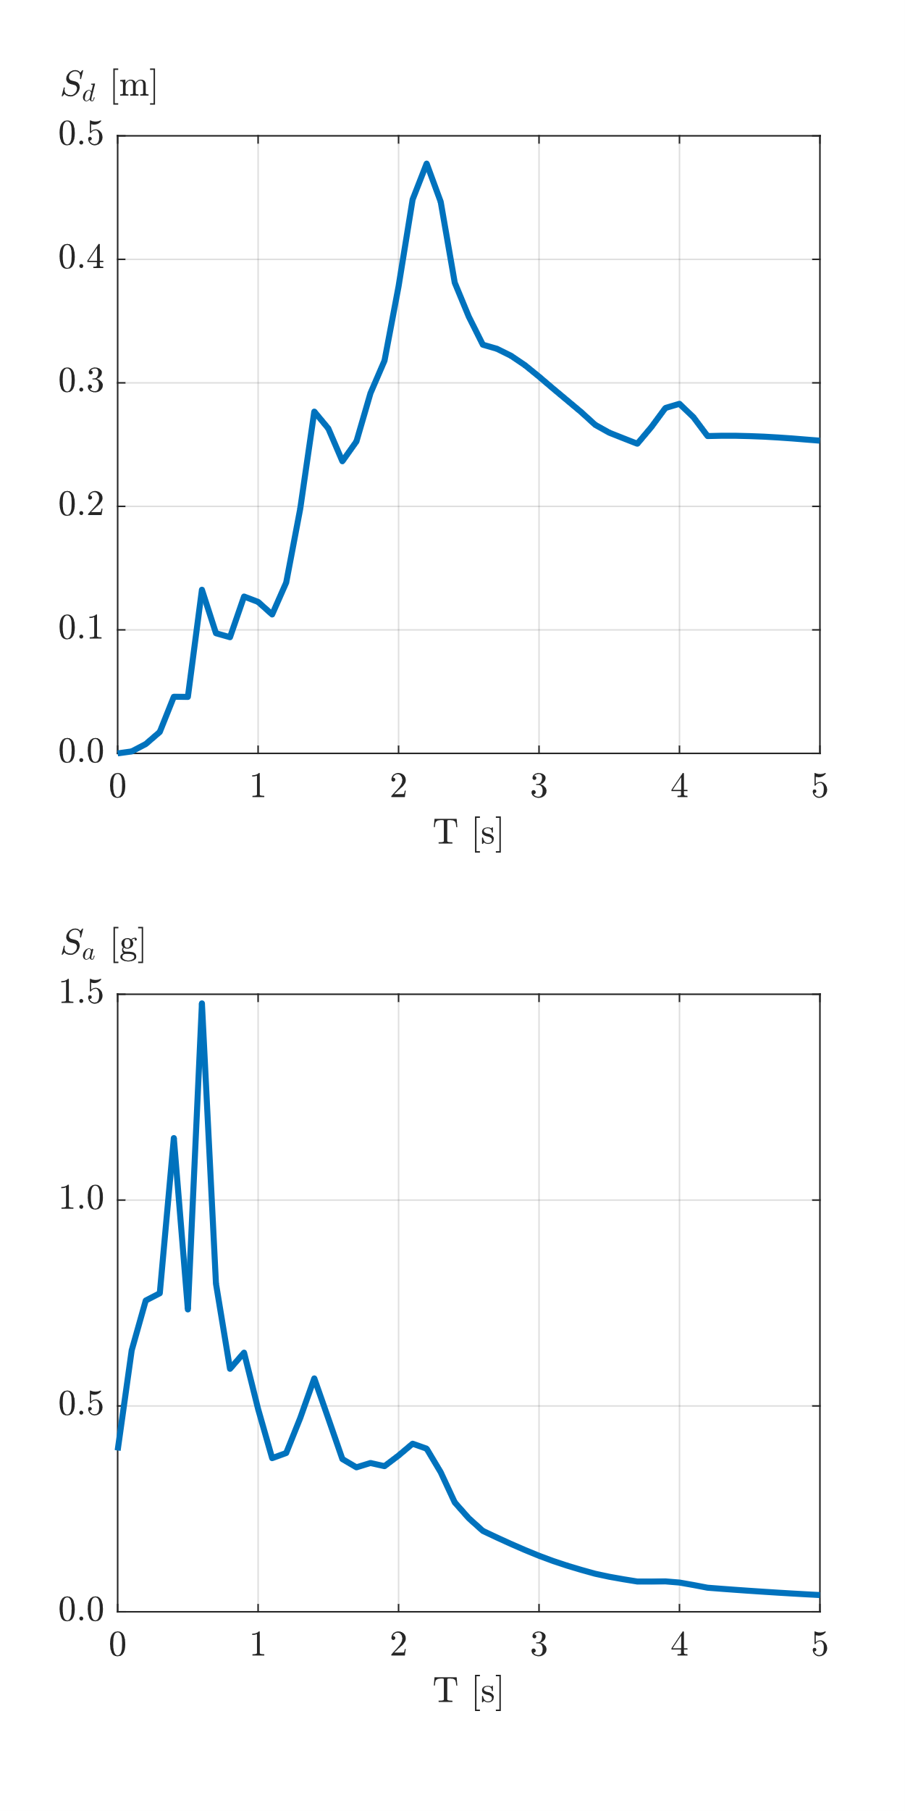
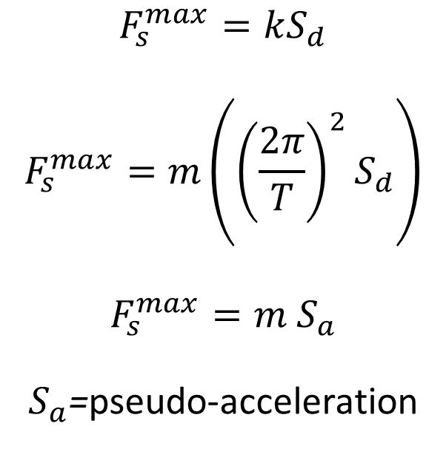

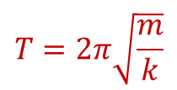
Pseudo-acceleration response spectrum
$$F_{s}^{max}=kS_{d}$$
$$F_{s}^{max}=m\left({\left(\frac{2π}{T}\right)}^{2}S_{d}\right)$$
$$F_{s}^{max}=m{ S}_{a}$$
$S_{a}$=pseudo-acceleration
$$T=2π\sqrt{\frac{m}{k}}$$
u
F_{i}(t)
$$m{\ddot{u}}_{g}$$
0.5F_{s}(t)
0.5F_{s}(t)
F_{d}(t)

Slide 9
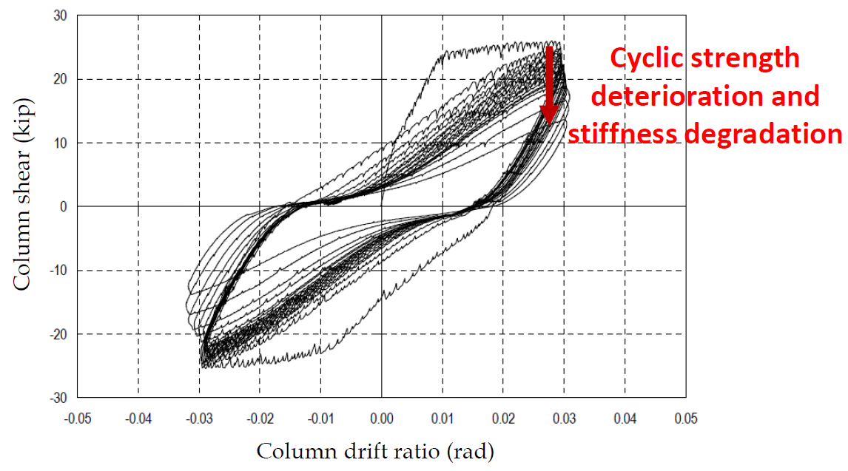
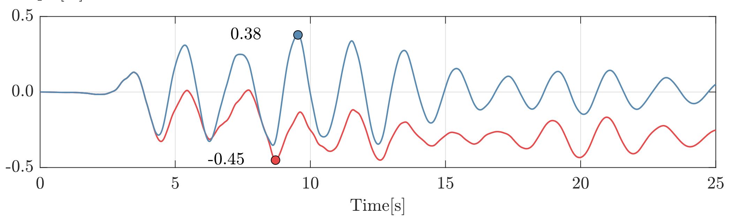
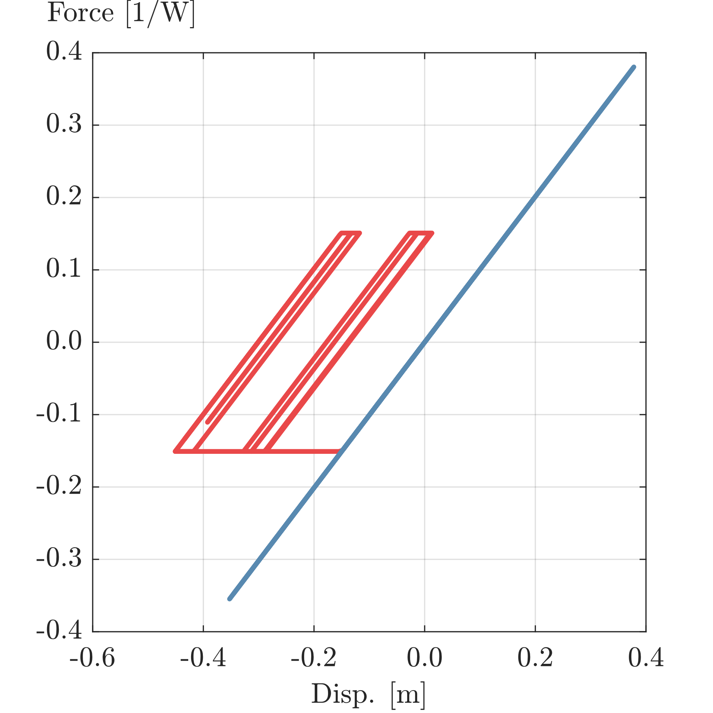
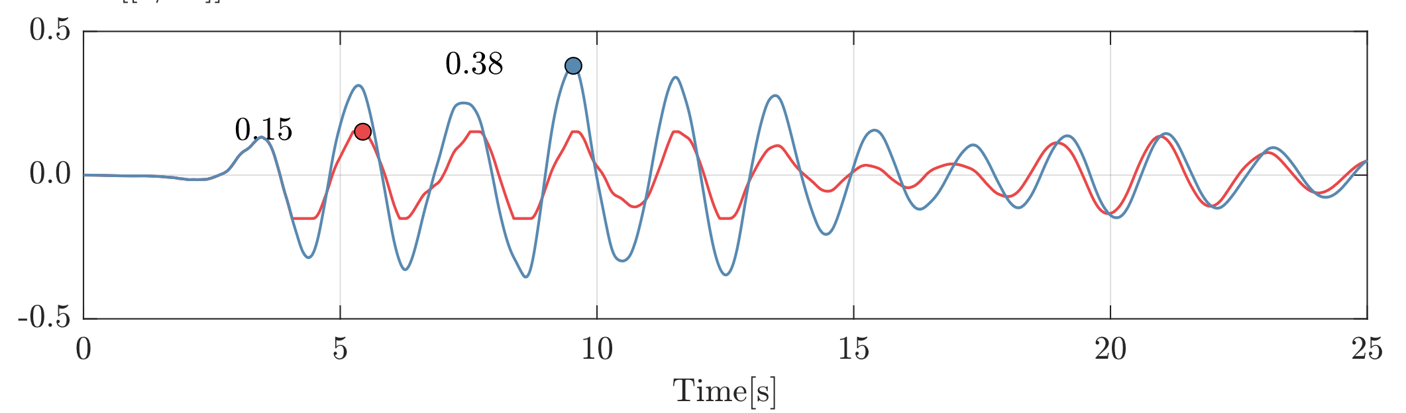

Linear vs Nonlinear
u
F_{i}(t)
F_{s}(t) for NL systems
$$m{\ddot{u}}_{g}$$
0.5F_{s}(t)
F_{d}(t)
Displacement response
Plastic
Elastic
Force response

Slide 10
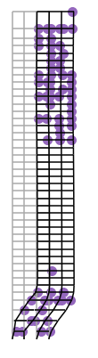
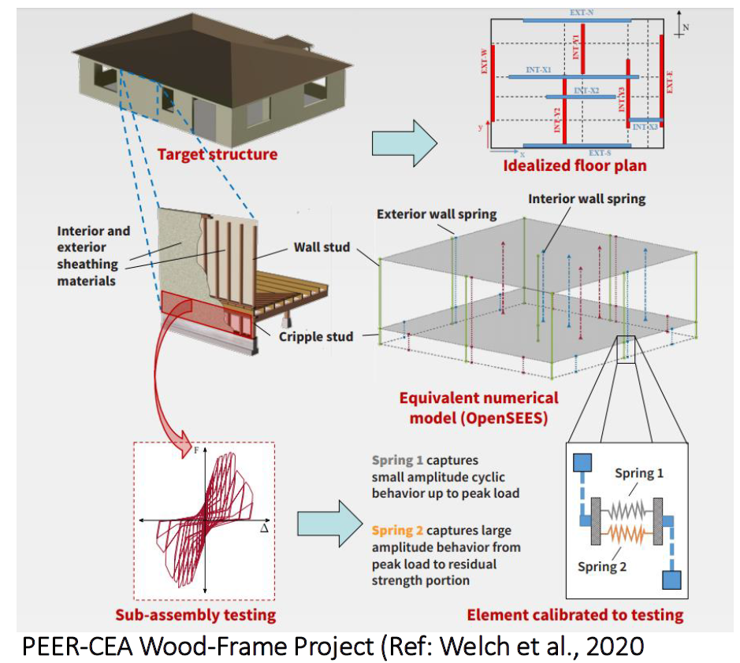
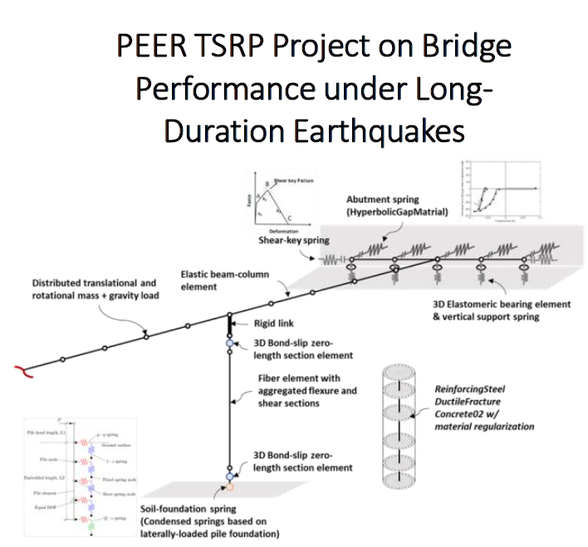
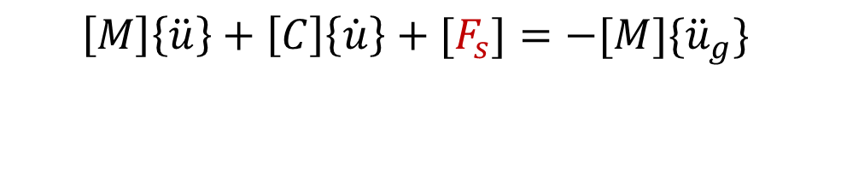
Multiple degrees of freedom
$$\left[M\right]\left\{\ddot{u}\right\}+\left[C\right]\left\{\dot{u}\right\}+[F_{s}]=−[M]\{{\ddot{u}}_{g}\}$$
NIST Tall WSMFs (Galvis and Deierlein, 2022)
(Zhong et al., 2020)

Slide 11




Application of NLRHA in Engineering practice

Slide 12
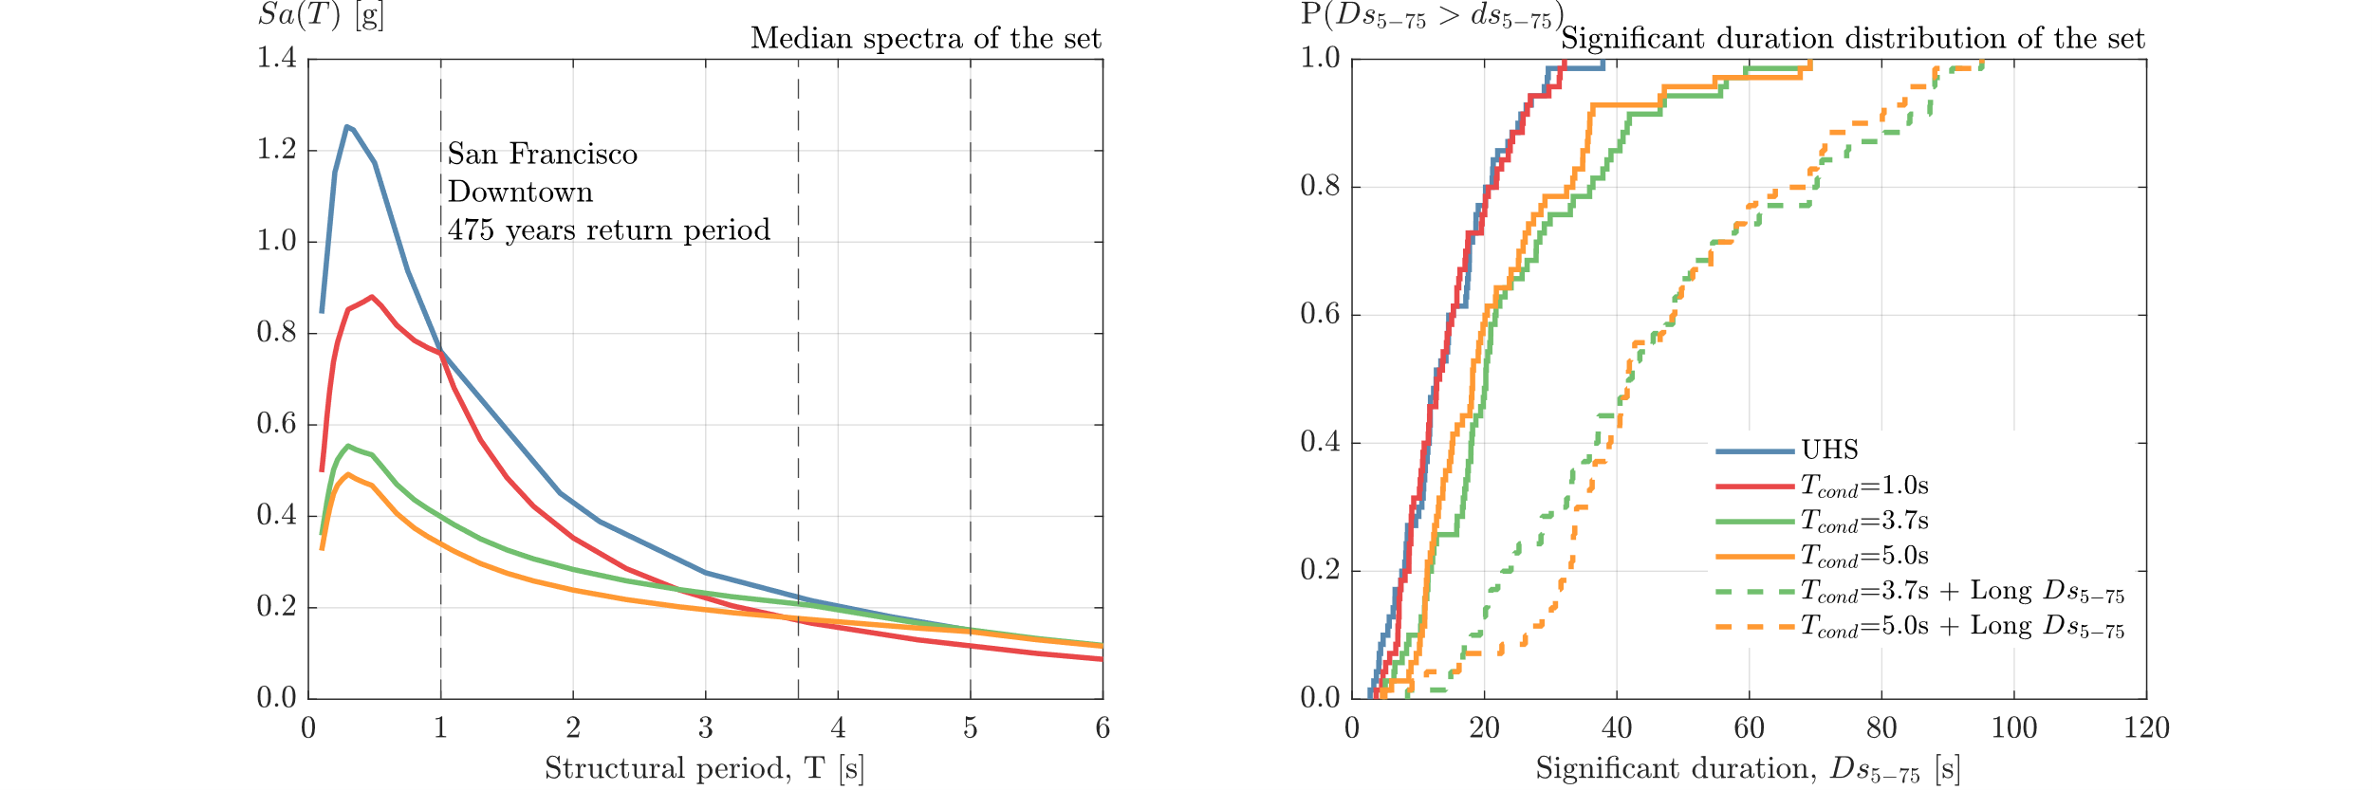
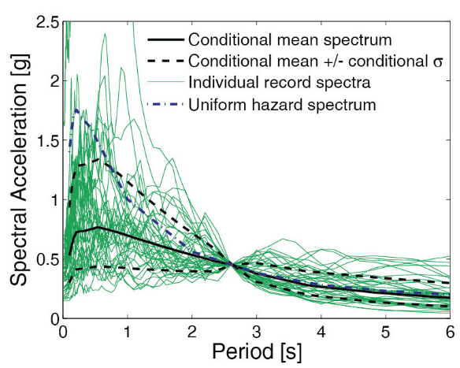
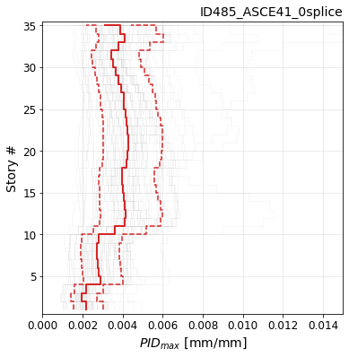
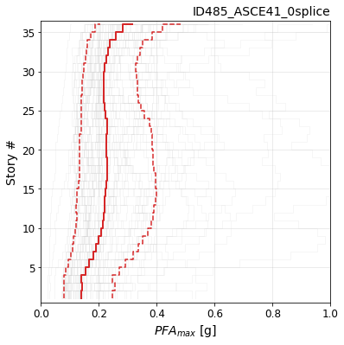
General workflow for NLRHA
Goal: quantify the response of a structure subjected to an external demand that varies with time.
Step 1: Build a numerical model of the structure
Step 2: Obtain the response spectrum target
Step 3: Select and scale ground motions
Step 4: Perform NLRHA
Step 5: Collect/parse results to interpret
$$\left[M\right]\left\{\ddot{u}\right\}+\left[C\right]\left\{\dot{u}\right\}+[F_{s}]=−[M]\{{\ddot{u}}_{g}\}$$

Slide 13
Step 1: Build a numerical model of the structure
Numerical model type:
Concentrated hinge model
Fiber hinge model
Distributed fiber element model
Continuous finite element model
Modeling assumptions:
2D Idealization vs. 3D model
Condensed vs. distributed mass
Gravity system and floor/slab constraints
Panel zone model
Software:
ETABS, PERFORM3D
ANASYS, ABAQUS
OpenSees
Fundamental period, T

Slide 14
Step 2: Obtain the response spectrum target
Intensity measure:
PGA, PGV, PGD
Response spectrum (PSA or Sa)
Ground motion duration (e.g., D_{S5-75})
Single vs. vector intensity measure
Seismic hazard:
Magnitude, mechanism, slip, …
Distance, soil profiles/velocity model
Local soil properties
Seismic disaggregation (return period)
Target response spectrum:
Uniform hazard spectrum (UHS)
MCE_{R}
Conditional mean spectrum
Conditional spectrum
UHS
ASCE MCEr
CMS

Slide 15
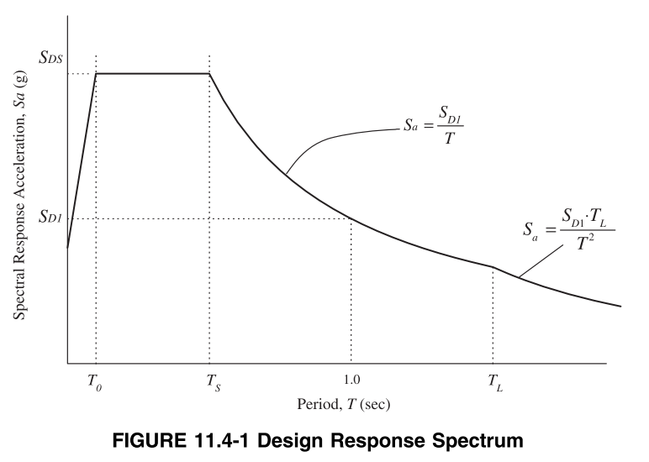

Step 2: Obtain the response spectrum target
MCE_{R}: Prescriptive intensity for new design
“It shall be permitted to use nonlinear response history analysis in accordance with the requirements of this chapter to demonstrate acceptable strength, stiffness, and ductility to resist maximum considered earthquake (MCER) shaking with acceptable performance…” - ASCE 7 Chapter 16
$$S_{DS}=\frac{2}{3}S_{MS}$$
$$S_{DS}=\frac{2}{3}S_{M1}$$
$$S_{MS}=F_{a}S_{s}$$
$$S_{M1}=F_{v}S_{1}$$
T_{L}
Site coefficients
From Seismic maps
(ASCE/SEI 7, 2016)

Slide 16
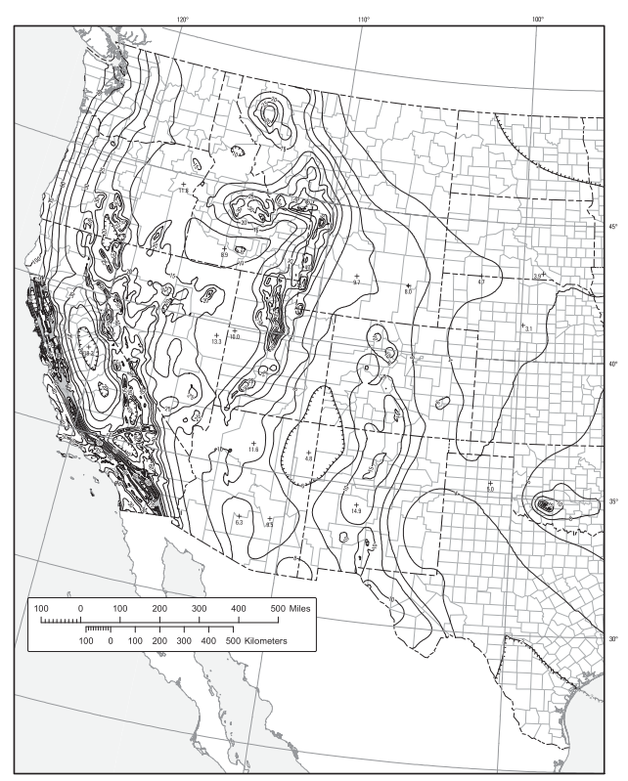
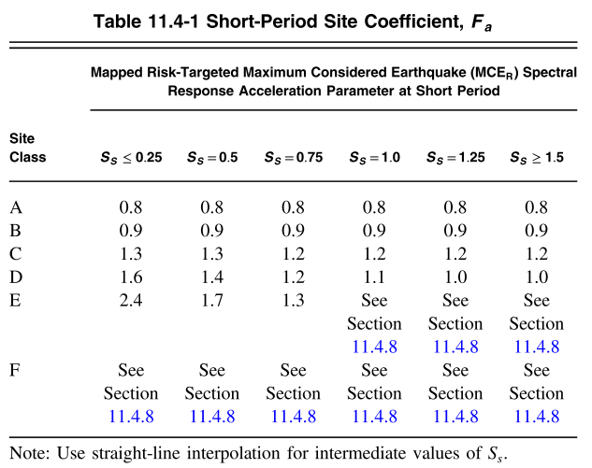
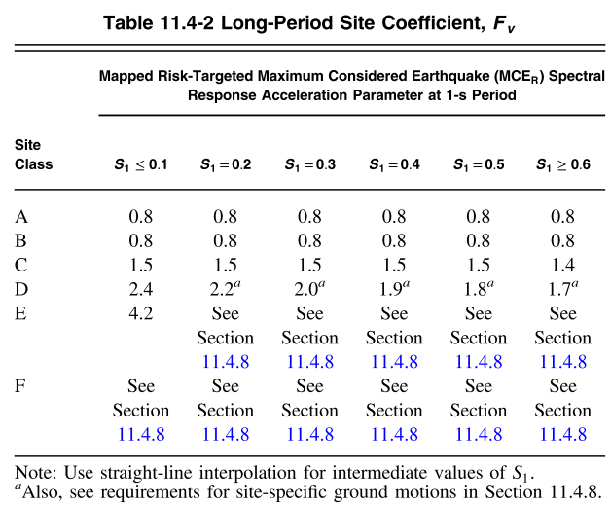
Step 2: Obtain the response spectrum target
(ASCE/SEI 7, 2016)

Slide 17
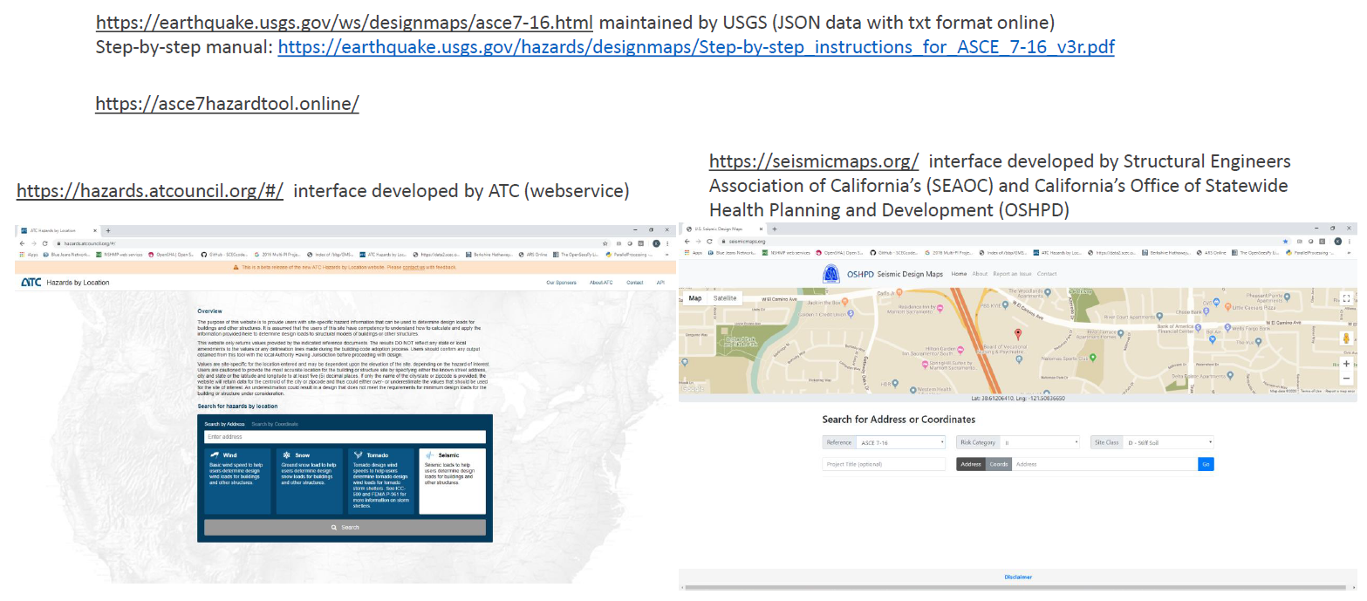
Step 2: Obtain the response spectrum target

Slide 18
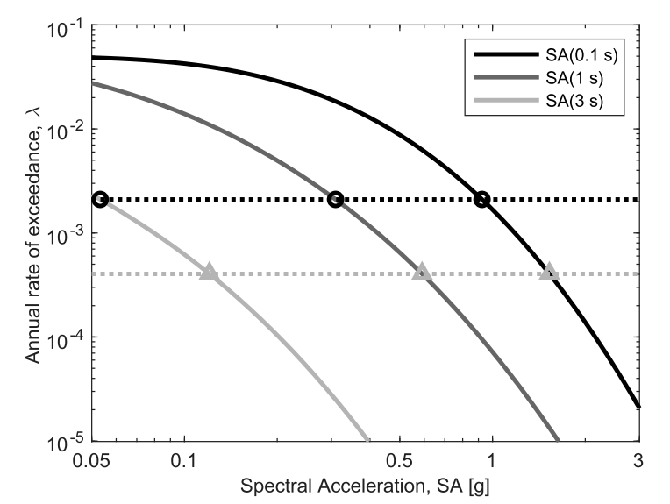
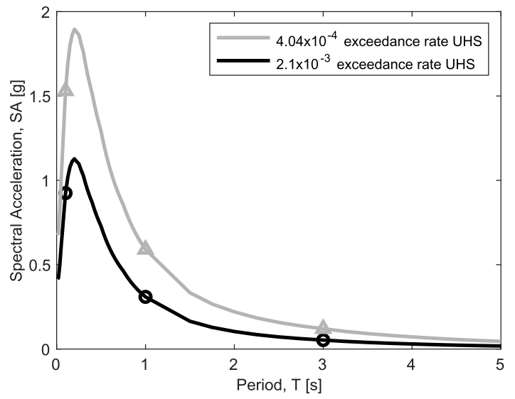
Step 2: Obtain the response spectrum target
UHS: Uniform Hazard Spectrum
Seismic hazard curve:
Measure the likelihood of exceedance of a shaking intensity (e.g. Sa(T))
Uniform Hazard spectrum:
Collects the Sa(T) values with
a same exceedance rate at different periods.
Both are pre-computed for all the United States by the USGS
(Baker et al. 2022)

Slide 19
Step 3: Select and scale ground motions
Key factors:
Number of records
Earthquake and site characteristics
Spectrum fitting (median/mean/std)
Period range
Scaling factor
Selection & scaling algorithm:
ASCE-7 type selection
CS-type selection
GCIM-type selection
Others:
Spectrally matching
Near-fault site
Seismic isolation

Slide 20
Step 3: Select and scale ground motions
ASCE 7 16.1: “… Ground motion acceleration history histories shall be selected and modified in accordance with the procedures of Section 16.2…”
Eleven ground motions MINIMUM for each target spectrum
Ground motions shall have similar spectral shape to the target spectrum
Each ground motion shall be scaled such that the average of all ground motions is equal or greater that 90% of the target response spectrum for any period between 0.2 T₁ ~ 1.5 T₁
Ground motions shall be selected from events with generally same tectonic regime (e.g. strike-slip earthquakes).
Ground motions shall be selected from events with generally consistent magnitudes and fault distances as the target intensity level
For near-fault sites (“7-15km, 6-10km”)*, the proportion of selected ground motions with directivity effects
For 3D models, ground motions shall consist of pairs of orthogonal horizontal components.

Slide 21
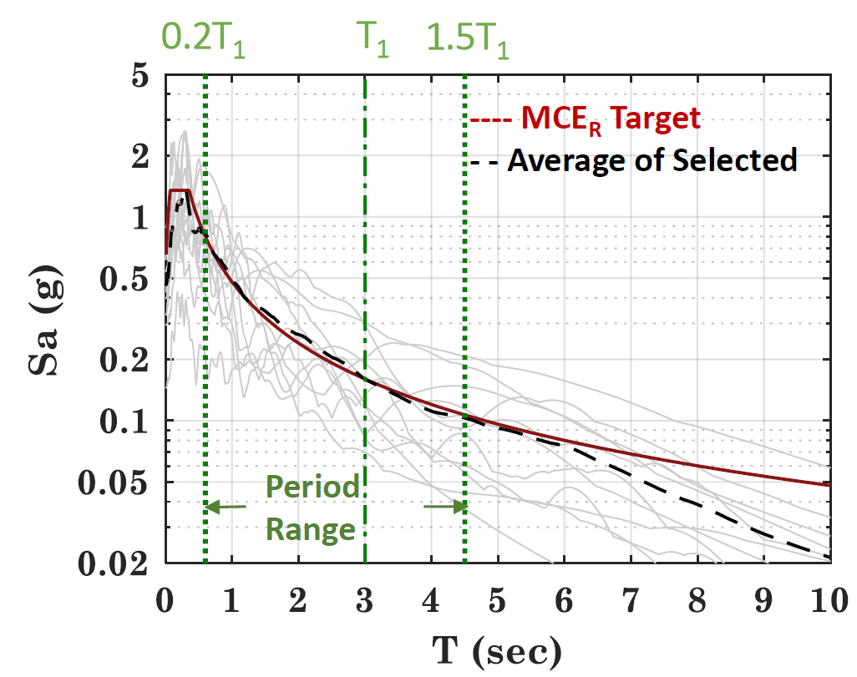
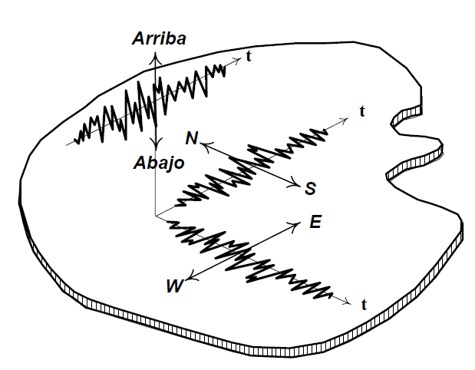
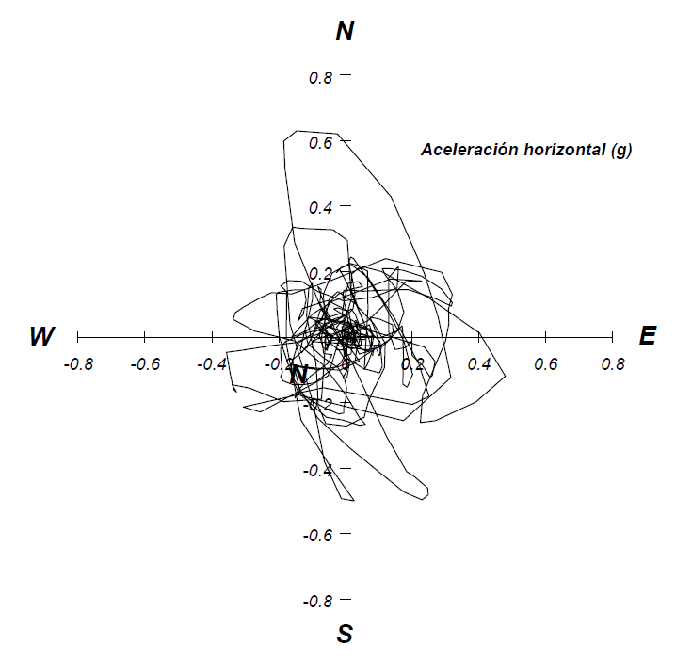
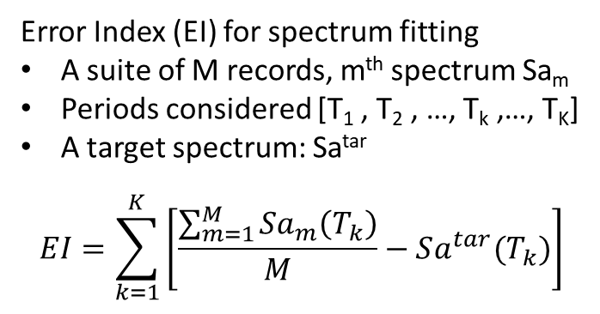
Step 3: Select and scale ground motions
Error Index (EI) for spectrum fitting
A suite of M records, m^{th} spectrum Sa_{m}
Periods considered [T₁ , T₂ , …, T_{k} ,…, T_{K}]
A target spectrum: Sa^{tar}
$$EI=\sum_{k=1}^{K}{\left[\frac{\sum_{m=1}^{M}{Sa_{m}\left(T_{k}\right)}}{M}−Sa^{tar}(T_{k})\right]}$$
Note: For 3D models one needs to select pairs of ground motions
Up
Down
(Garcia, 1998)

Slide 22
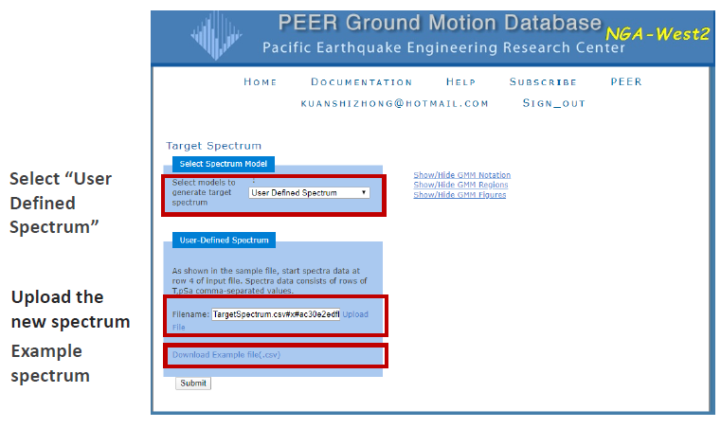
Step 3: Select and scale ground motions
PEER Database
PEER offers ground motion recordings in the NGA West 2 database, which contains roughly 20000 ground motions from worldwide: https://ngawest2.berkeley.edu
Sign up (free) and log in to get access to the ground motion selection page
Demo live

Slide 23
Step 4: Perform NLRHA
Algorithm:
Implicit: Newton, Newton Initial…
Explicit: central deferential
Damping:
Modal damping
Rayleigh damping (initial, committed, current)
Convergence:
Error indices
Time step
Number of iterations

Slide 24
Step 5: Collect/parse results to interpret
Response check:
Peak story drift (structural damage)
Peak floor acceleration (non-structural damage)
Element forces (capacity design)
Statistics: Average, median, dispersion

Slide 25



Example
Goal: quantify the response of a structure subjected to an external demand that varies with time.
Step 1: Build a numerical model of the structure
Step 2: Obtain the response spectrum target
Step 3: Select and scale ground motions
Step 4: Perform NLRHA
Step 5: Collect/parse results to interpret

Slide 26
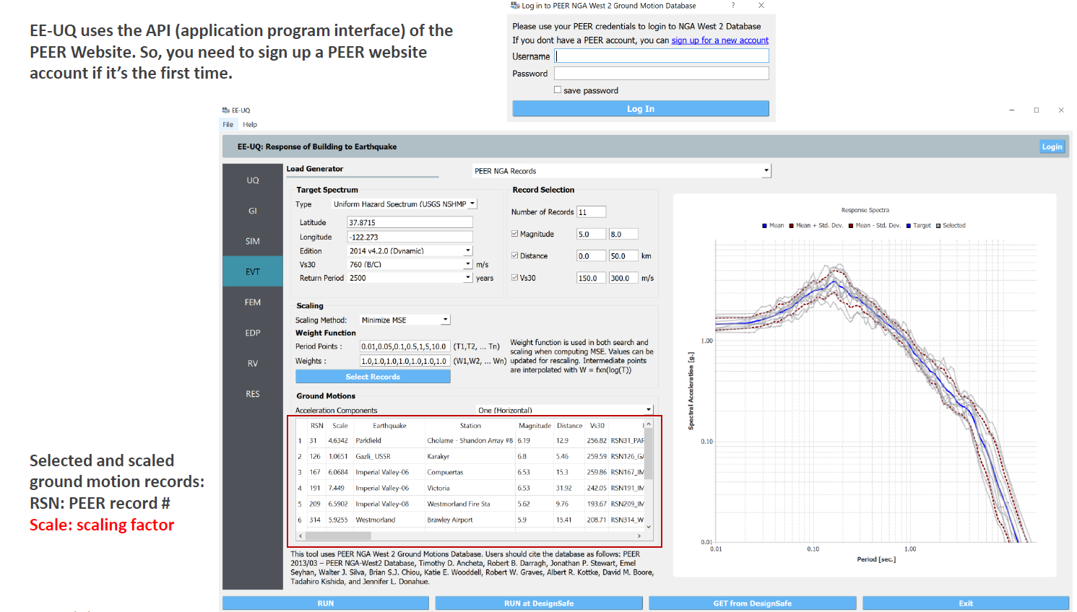
Example
Demo live

Slide 27
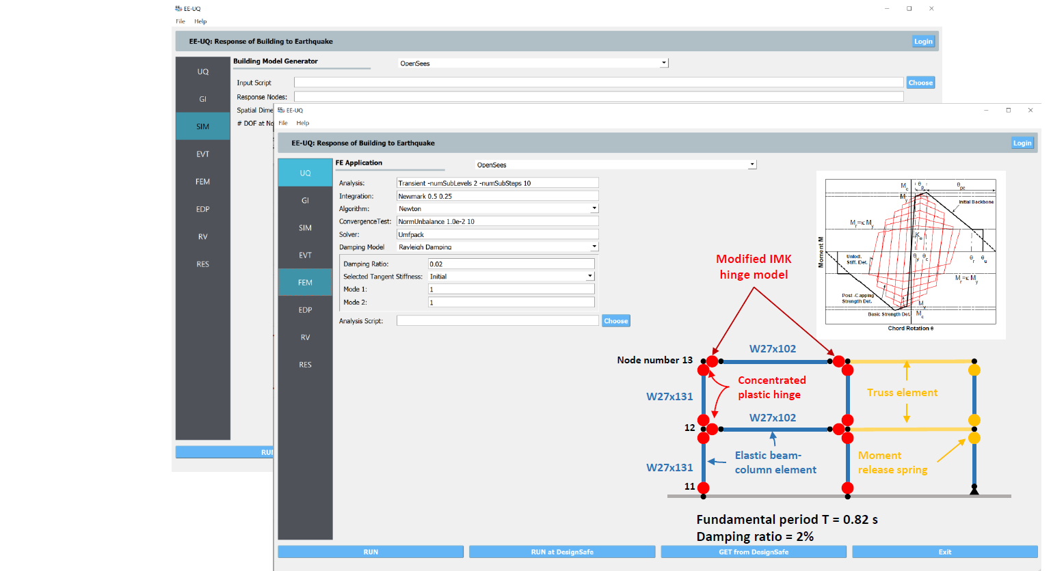
Example

Slide 28
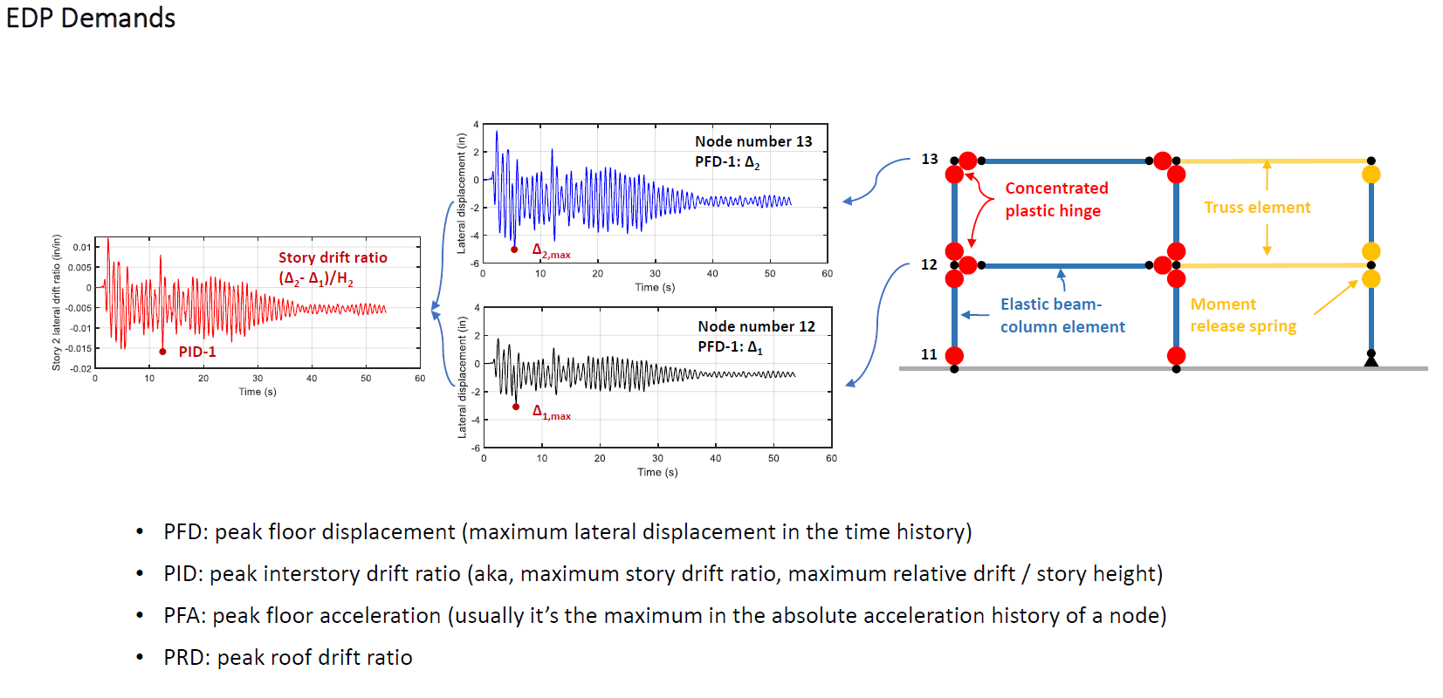
Example

Slide 29
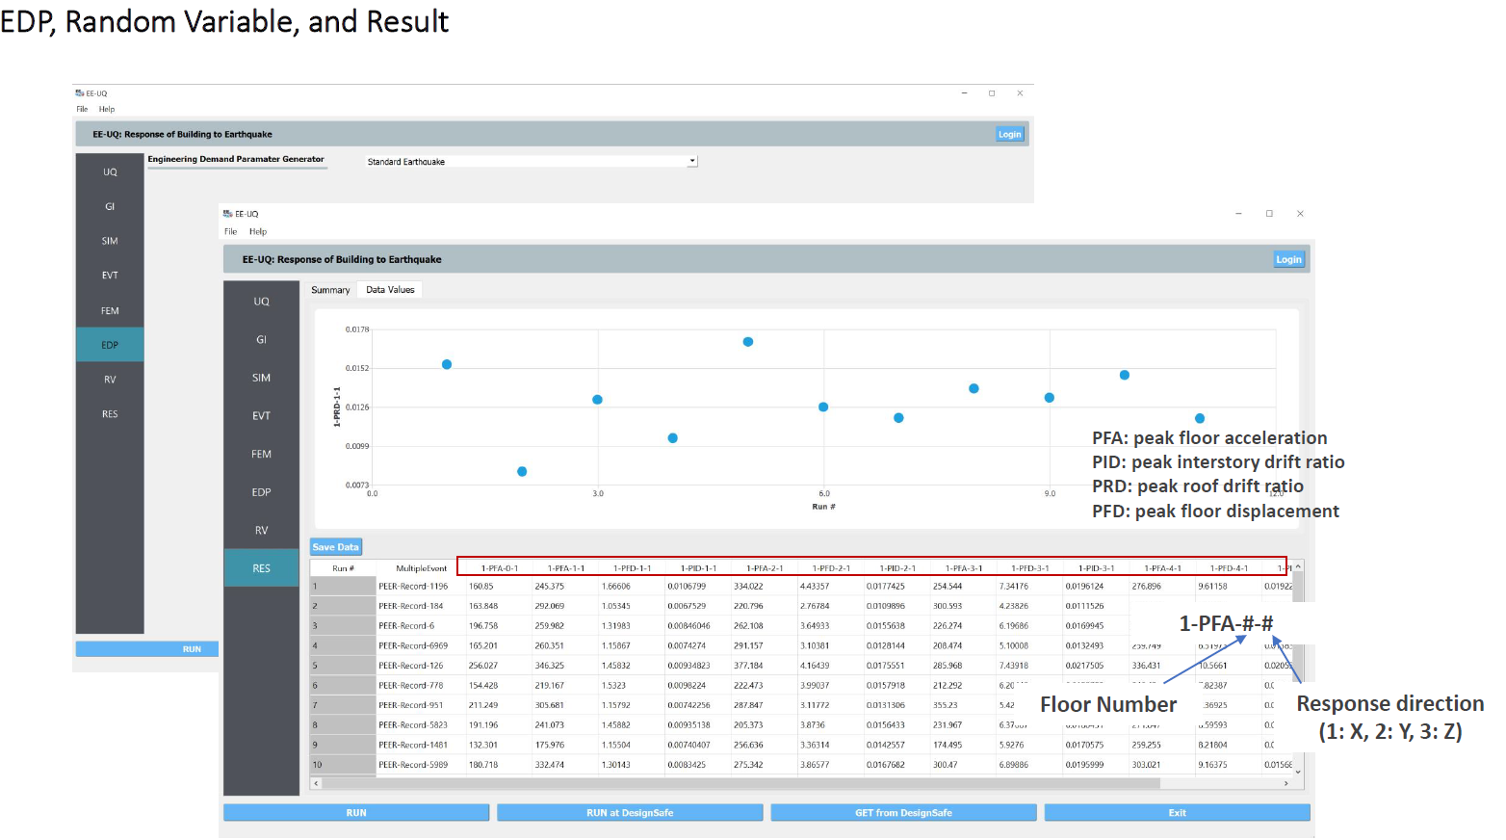
Example

Slide 30
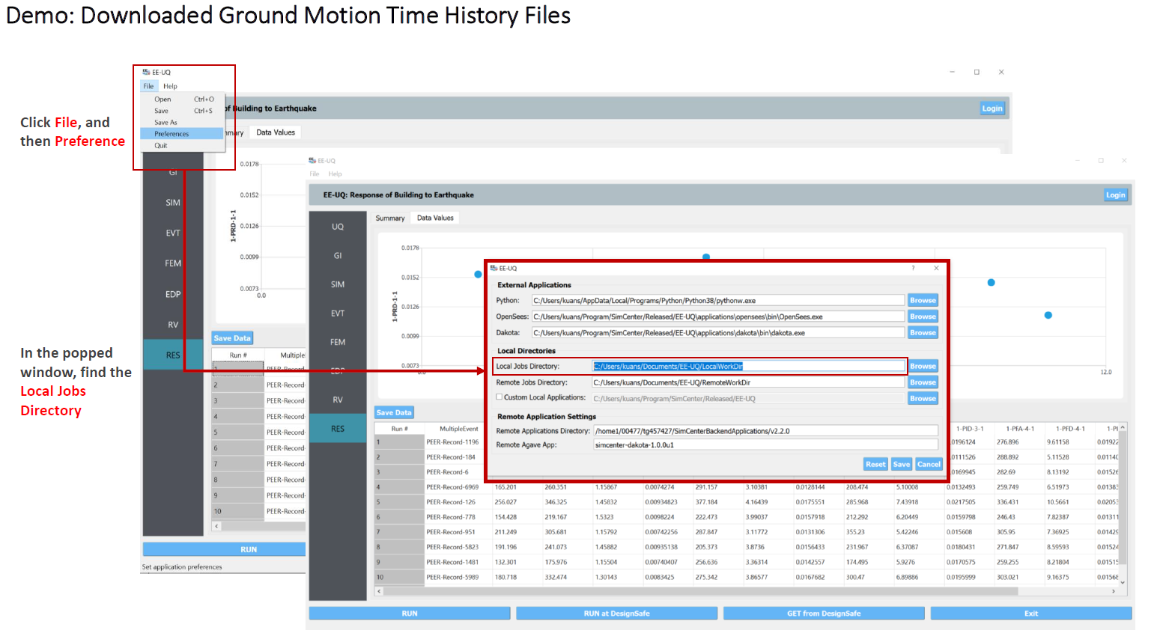
Example

Slide 31
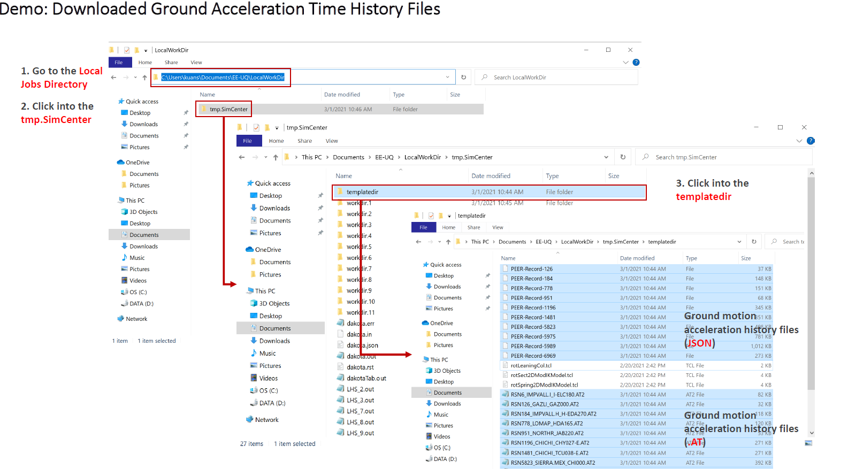
Example

Slide 32
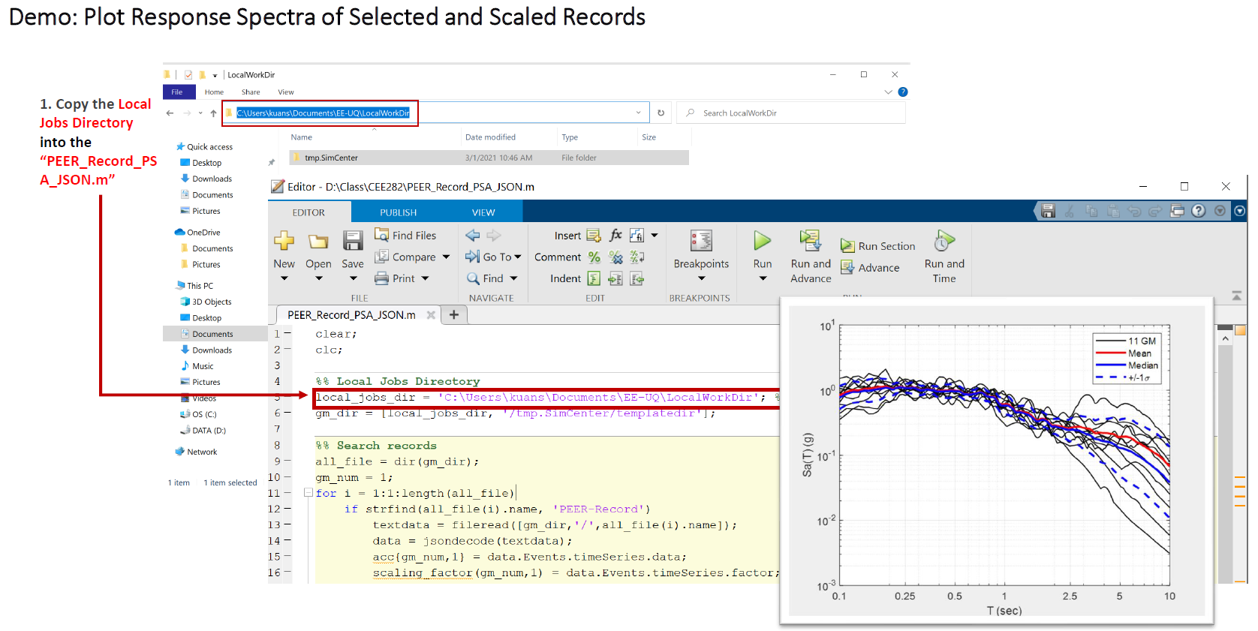
Example

Slide 33
Ground motion selection and scaling for NLRHA
Introduction to nonlinear response history analysis (NLRHA)
General workflow for NLRHA
Ground motion selection and scaling criteria
Example

